Slide 1

Vibration Reduction in a Grass Trimmer Using Multi-Axial Absorbers
B.Tech Project Evaluation (BTP)
Presented by
Macharla Aravind (220003050)
Department of Mechanical Engineering
Supervised by:
Prof. Anand Parey
Department of Mechanical Engineering
Indian Institute of Technology Indore

Slide 2
Contents
Introduction
Literature review
Motivation
Methodology
Works Done
Results
Conclusions
Future work
References

Slide 3
Introduction
Problem Statement:
Weed-cutter (grass-trimmer) machines generate strong vibrations from the engine, rotating cutter head, and transmission system.
These vibrations travel directly to the operator’s hands through the handle.
The vibration levels often exceed the recommended exposure limits defined by ISO 5349.
Long-term exposure can lead to discomfort, fatigue, and serious health issues such as Hand–Arm Vibration Syndrome (HAVS).
Current machines generally lack effective built-in solutions to isolate or reduce multi-directional (multi-axial) vibrations at the handle.
Objective :
The project aims to design, fabricate, and validate a multi-axial vibration absorber for a weed-cutter.
The absorber will be tuned using an active-force/node-imposition method.
A vibration node will be imposed at the handle, reducing harmful vibrations reaching the operator.
The goal is to ensure effective vibration reduction that complies with ISO hand–arm vibration standards

Slide 4
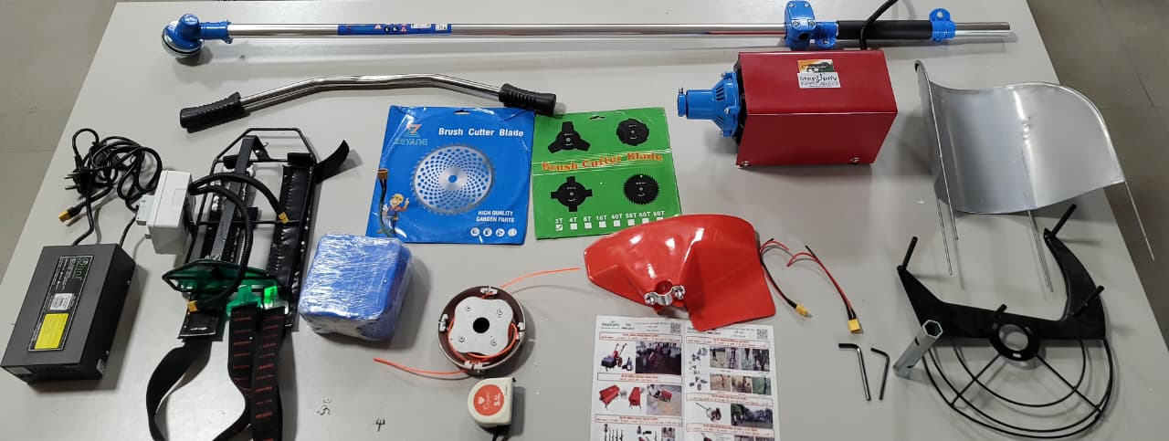
Introduction
Information About Weed cutter ,I am working on
Engine | STEPUPIFY Brush Cutter 26volt
Power output | 3150 r/min
Pipe diameter | 25 mm
Size (L×W×H) | 1890 mm × 340 mm × 150 mm
Weight | 9.8655 kg
Length of the trimmer rod | L | 1.55 m
Mass of rod , drive shaft | m | 1.879 kg
Weight of handle | m2​ | 0.6375 kg
Weight of engine | m3​ | 5.3 kg
Cutter head location | x1​ | 30 mm
Handle location | x2​ | 1020 mm
Engine location | x3​ | 1560 mm

Slide 5
Literature review
Author’s | Title of paper | Work Summary
P.D. Cha et.al.[1] | Imposing nodes at arbitrary locations for general elastic structures during harmonic excitations. | Author’s have reviewed the following fundamental key aspects: The assumed modes method to formulate equations and determine spring-mass parameters to create nodes. The procedure differs for two cases: the collocated case, which has a simple solution; and the non-collocated case, which requires solving non-linear equations. Authors summarized that It's always possible to tune absorber parameters to induce multiple nodes if absorber locations and node locations coincide. A region of near-zero amplitude can be created if desired node locations are closely spaced.
Cha PD and Rinker JM et.al.[2] | Enforcing nodes to suppress vibration along a harmonically forced damped Euler-Bernoulli beam. | An indirect approach based on the active force method, where to replace the oscillators with unknown restoring forces, solve a set of linear algebraic equations to determine these forces, and then use them to tune the oscillator parameters. The takeaway is, the TVAs are highly effective. For ex, one paper reports a 95% reduction in acceleration when the TVA was placed at 0.025L, while another achieved near-zero vibration at the handle using two absorbers

Slide 6
Literature review
Author’s | Title of paper | Work Summary
Cha PD and Buyco K et.al.[3] | An Efficient Method for Tuning Oscillator Parameters in Order to Impose Nodes on a Linear Structure Excited by Multiple Harmonics | Active force method, where they first calculate the restoring forces needed to create nodes (points of zero vibration) and then use those forces to tune the parameters of the vibration absorbers. The method in paper allows for the easy creation of design plots to determine the correct oscillator parameters, enabling the placement of multiple nodes on a structure even with multiple harmonic excitations.
Patil SS and Awasare PJ et.al.[4] | Vibration reduction at desired locations on a beam by creating nodes using tunable vibration neutralizers | Iterative procedure to find the specific resonance frequencies of variable stiffness vibration neutralizers needed to create nodes, or points of zero vibration, on a beam. The numerical and experimental tests, that a developed iterative procedure can effectively identify the resonance frequencies required for vibration neutralizers to create nodes and reduce vibrations at desired locations on a beam..
Hao KY, Mei LX and Ripin ZM et.al.[5] | Tuned vibration absorber for suppression of hand-arm vibration in electric grass trimmer | Modal Analysis, Operating Deflection Shape (ODS) analysis, and TVA design and fabrication

Slide 7
Literature review
Author’s | Title of paper | Work Summary
Nor AA, Mohad IG, Musli NY et.al.[6] | Hand-arm vibration disorder among grass-cutter workers in Malaysia | The study measured and evaluated the hand-arm vibration (HAV) and personal noise exposure characteristics of five different types of hand-held grass cutter machines during normal operation. Measurements were performed on-site according to Malaysian regulations. The estimated daily vibration exposure, A(8), ranged from 2.7 to 29.1~m/s^2 for the left hand and 2.1 to 20.7~m/s^2 for the right hand. The mean A(8) values for both hands across all machine types exceeded the Exposure Action Value (EAV) of 2.5~m/s^2.
Mohamad HA, Nor AA and Musli et.al.[7] | Prediction on hand arm vibration exposure cause-effect among grass-cutting workers in Malaysia | Grass-cutting workers in Malaysia are exposed to high hand-arm vibration levels, with daily vibration values exceeding the recommended exposure action value of 2.5 m/s², leading to a high prevalence of hand–arm vibration syndrome (HAVS) symptoms such as finger colour change (reported by 80% of workers). The study developed a Hand Arm Vibration Exposure Risk Assessment (HAVERA) process, combining both subjective data (symptoms, numerical scoring) and objective measurements (vibration magnitude, hand grip strength).

Slide 8
Motivations
High hand–arm vibration exposure in grass-trimmer operators The long-term exposure leads to HAVS (Hand–Arm Vibration Syndrome) including vascular, neurological and musculoskeletal disorders.
Grass trimmers show high vibration near handle region The measured peak acceleration is extremely high for prolonged use, making reduction essential from an occupational safety perspective.
Need for a practical, low-cost solution that can be added to existing machines The aim is to design a simple, adjustable absorber that can be fabricated easily and mounted on any grass trimmer without modifying OEM design.
Improve worker health, comfort, and productivity Reducing handle vibration directly improves the usability, safety, and operator comfort in long-duration field operations.
First implementation of a multi-axial (dual-direction) vibration absorber Instead of one-axis absorbers, this research develops a device that simultaneously suppresses vibration in both x and z directions, matching actual trimmer vibration behaviour.
Tunable design using dual cantilever beams with movable masses The absorber uses threaded rods with sliding end masses, allowing quick tuning to match engine excitation frequency (~52 Hz). This adjustability is a major novelty.
Collocated tuning concept The absorber is placed exactly at the handle location, where vibration reduction is needed, making the control highly effective.

Slide 9
Methodology
Methodology :
Grass-trimmer System.
Modelling.
Experimental Modal Analysis (EMA).
Compute absorber parameters (stiffness & mass).
Absorber hardware & fabrication / tuning procedure
Validation & reporting.

Slide 10
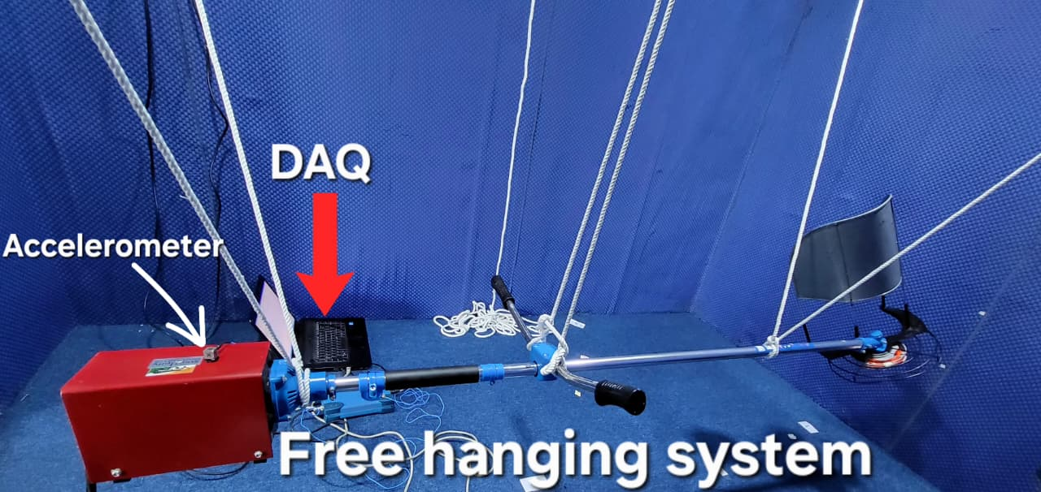
Methodology
Grass trimmer System : This system uses a tri-axial accelerometer, a multi-channel DAQ, and MATLAB to perform modal analysis on a weed-cutter. It can use either an impact hammer or a modal shaker for excitation and includes a tachometer to record the operating speed. The data is logged and organized for reporting.
Fig2.Complete grass trimmer system for experimental data collection
Modelling : Build a beam model with lumped masses (engine, head, handle) or run FEM. Compute first N modes (mass‑normalized) to get mode shapes φi(x). Imposing nodes at arbitrary locations for general elastic structures during harmonic excitations.Use active‑force linear system to compute required restoring force for node (if non‑collocated) or tune collocated absorbers to ω.

Slide 11
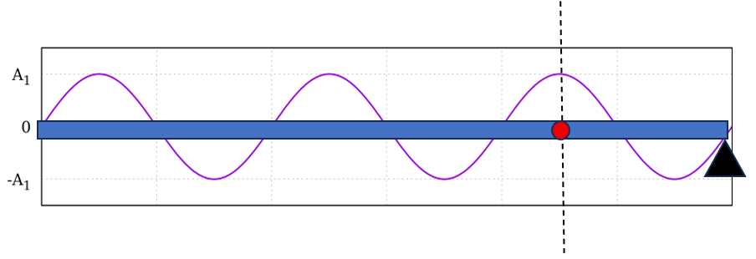
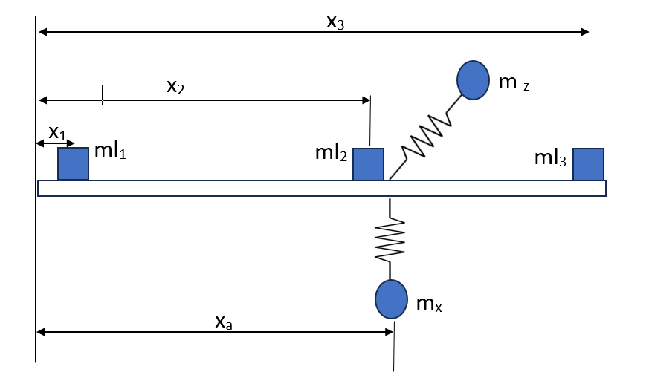
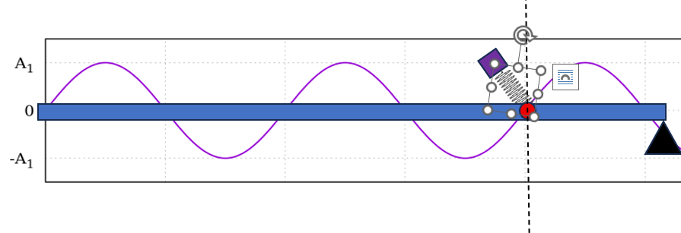
Methodology
In many vibration problems, we want a specific point on a beam or elastic structure to remain at zero displacement during harmonic vibration. In modal terms, we want to create a node at that point.
Fig 3. Lumped mass system of Grass trimmer
Fig 4. Imposing Node at desired location

Slide 12
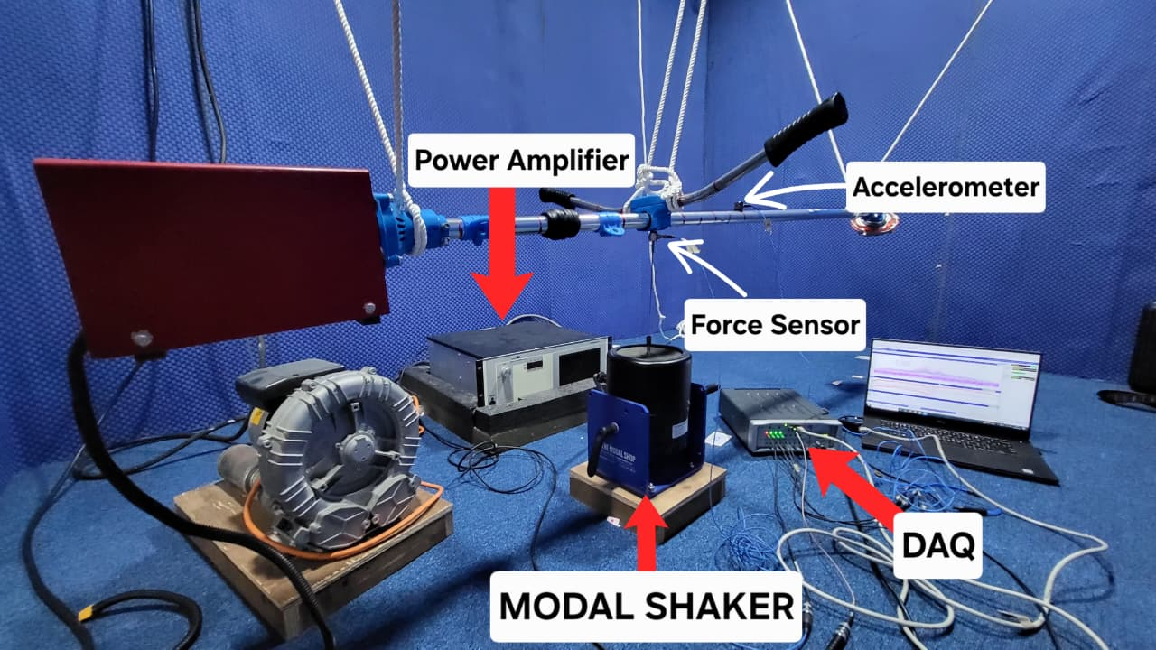
Methodology
Experimental Modal Analysis (EMA):
EMA gives the actual natural frequencies, damping, and mode shapes, which cannot be reliably obtained from theory alone. This helps identify exactly where the structure bends and where vibration concentrates.
EMA reveals which frequencies cause excessive vibration and whether the structure is operating close to a resonance. This is essential for diagnosing vibration issues and preventing failures or discomfort.
EMA shows the real node and anti-node locations, helping engineers decide where to add mass, stiffeners, or absorbers to reduce vibration effectively.
Fig 5. Experimental Modal analysis Setup

Slide 13
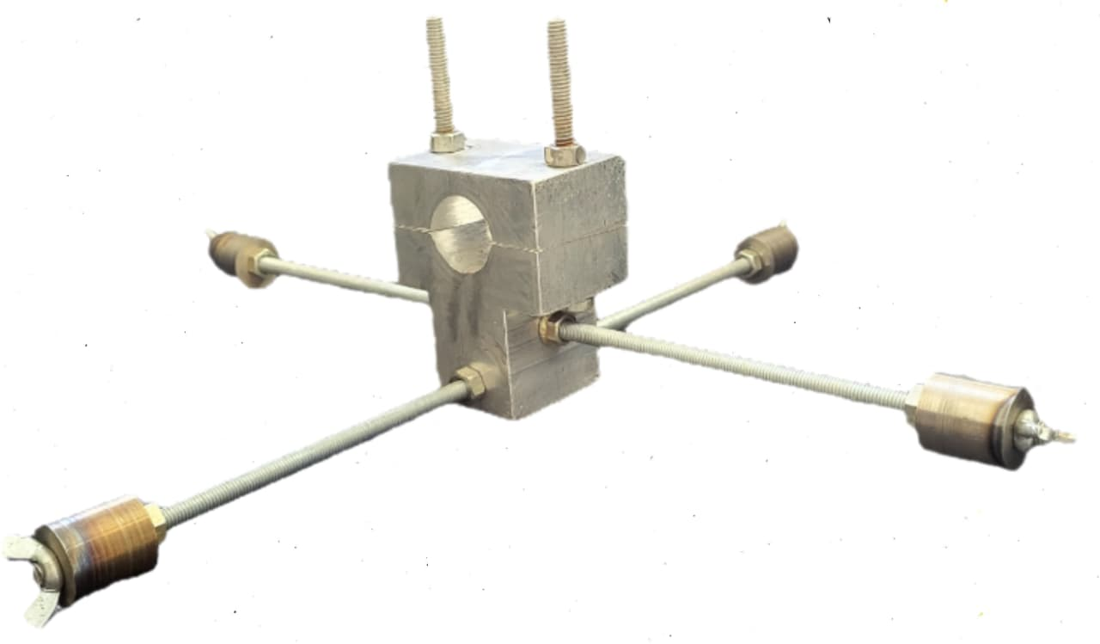
Methodology
Absorber hardware & fabrication / tuning procedure :
The absorber was designed specifically to counter the 52 Hz vibration peak, identified through experimental modal analysis. All dimensions—including rod length, mass size, and mass position—were chosen so that the absorber’s natural frequency aligns precisely with this excitation frequency, ensuring maximum vibration reduction.
A four-rod, orthogonal configuration was selected to provide equal damping in both X and Z directions, without introducing unwanted torque at the handle. This symmetric geometry distributes masses uniformly around the handle, making the absorber dynamically stable, compact, and safe for continuous operator use.
Fig 6.Multi axial vibration absorber

Slide 14
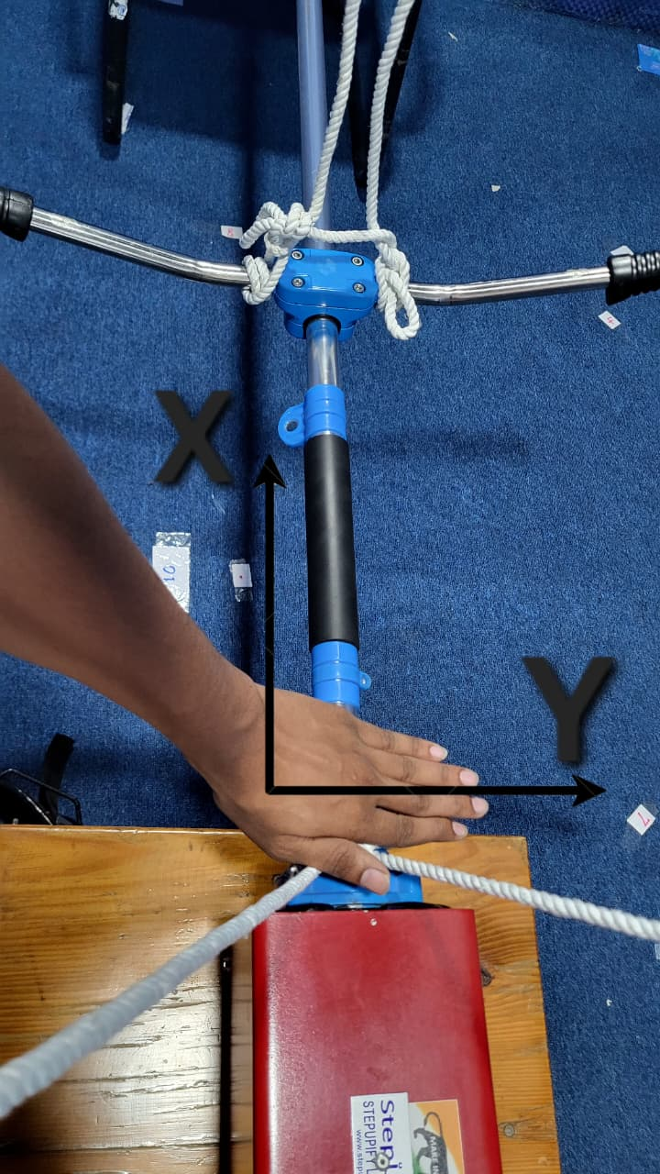
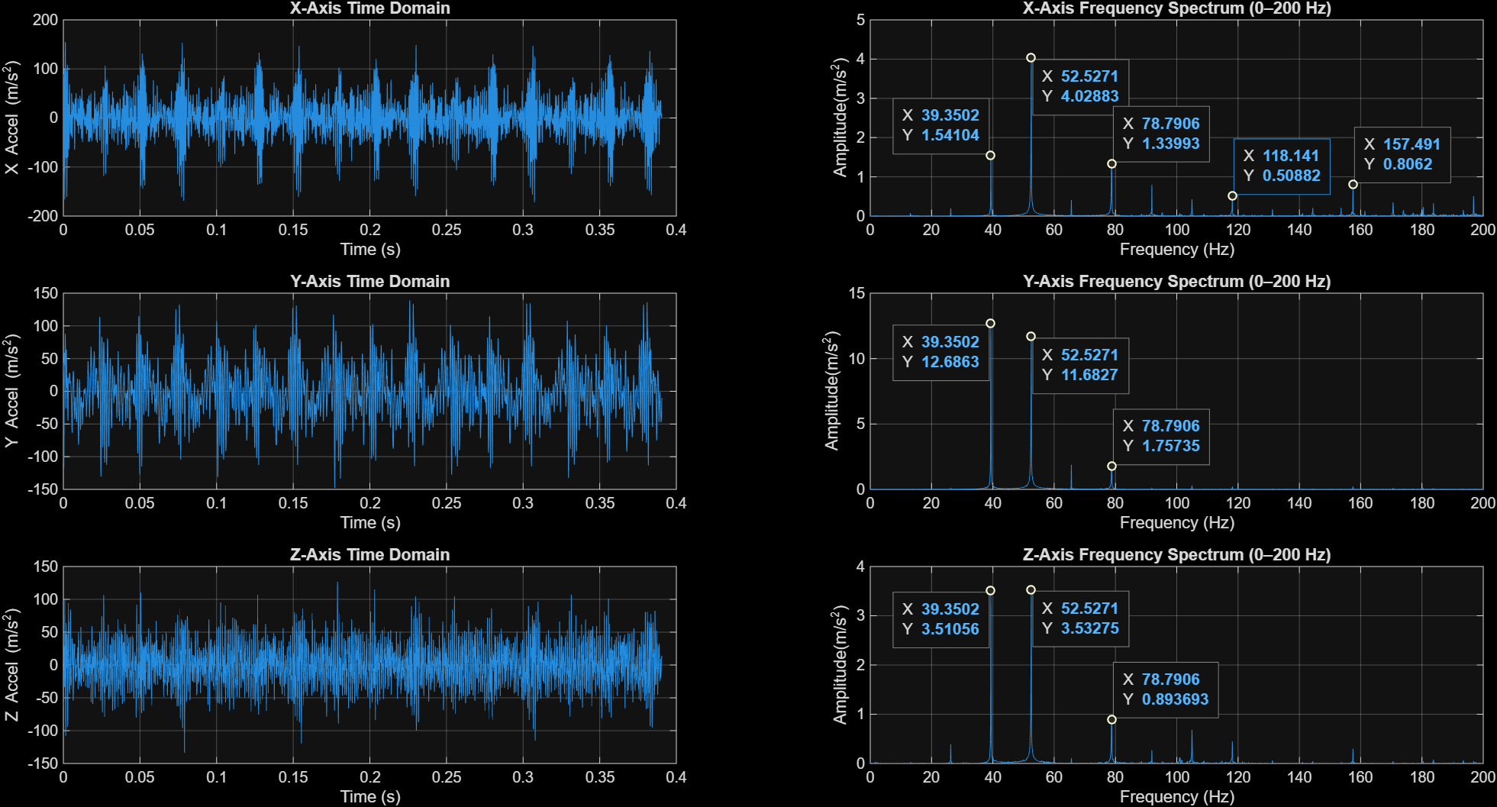
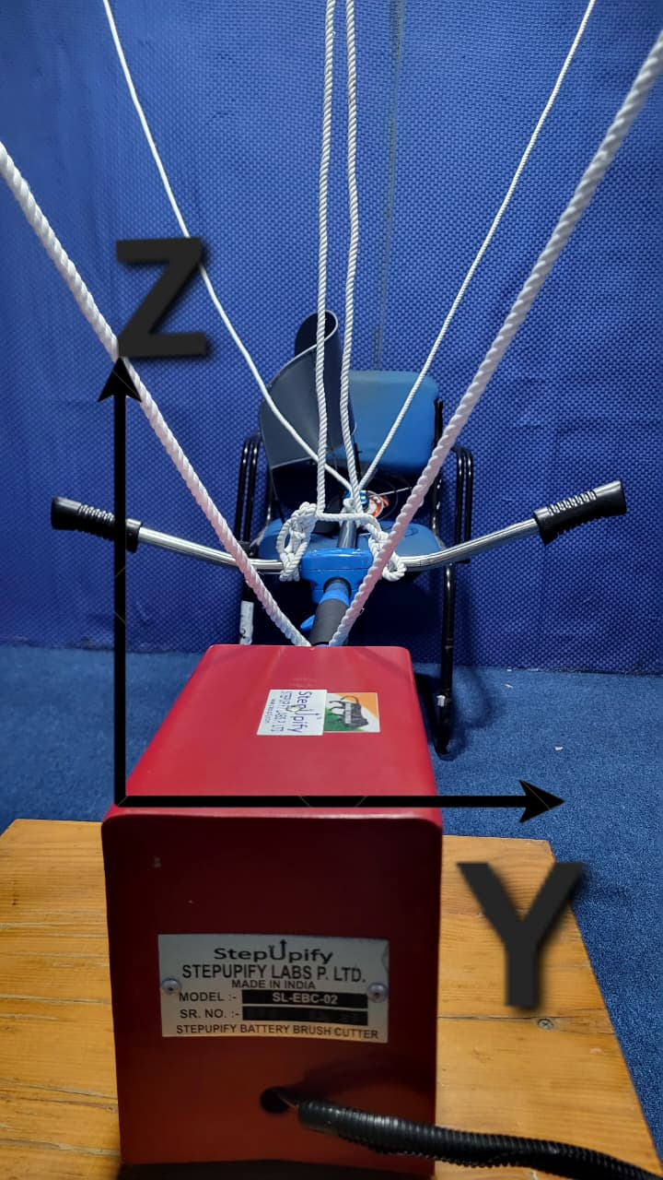
Works Done
Works Done :
Studied vibration levels at grass trimmer handle (found 52Hz dominant).
Compute absorber parameters (stiffness & mass).
Performed experimental modal analysis to identify natural frequencies and mode shapes.
Designed a new multi-axial absorber using Dunkerley’s equation.
Fabricated absorber with 0.1 kg end masses and 7mm rods.
Mounted absorber near handle and tuned to 52Hz.
Measured vibration reduction in x, y, z directions..
Studied vibration levels at grass trimmer handle (found 52 Hz dominant):
(b)
Fig 7.
Time and frequency spectrum for the primary system (i.e. without absorber).
(b).(c) Directional convention.
(c)
(a)

Slide 15
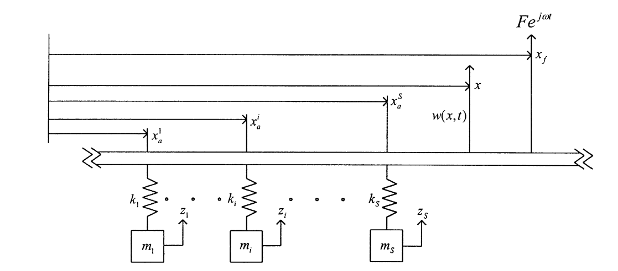
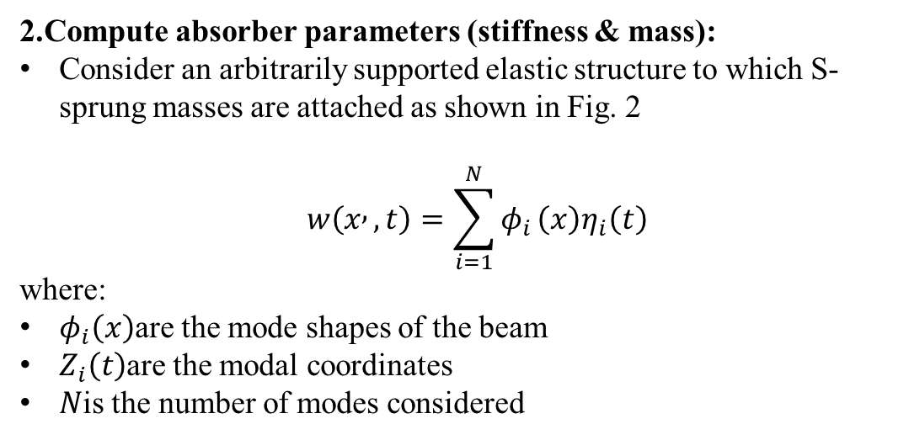
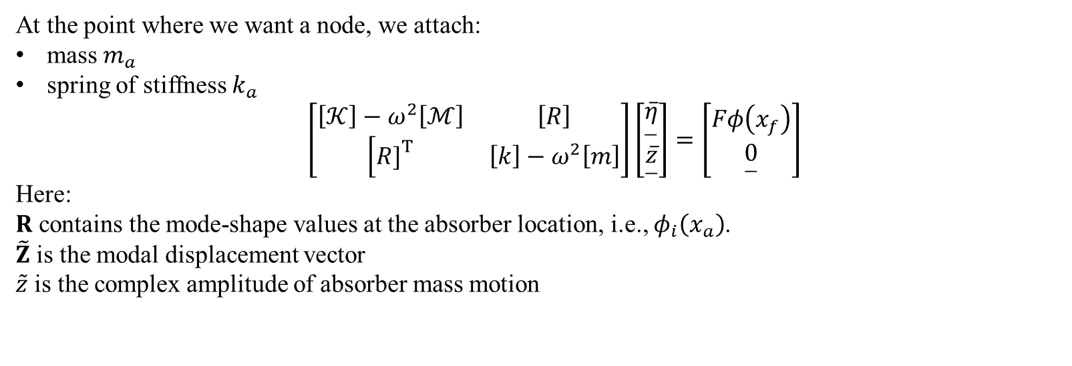
Work Done
2.Compute absorber parameters (stiffness & mass):
Consider an arbitrarily supported elastic structure to which S-sprung masses are attached as shown in Fig. 2
$$\begin{matrix} & w\left(x , ,t\right)=\sum_{i=1}^{N}{φ_{i}}\left(x\right)η_{i}\left(t\right)\end{matrix}$$
where:
$φ_{i}\left(x\right)$are the mode shapes of the beam
$Z_{i}\left(t\right)$are the modal coordinates
$N$is the number of modes considered
Fig 8.An arbitrarily supported elastic structure that is subjected to a localized harmonic excitation and carrying any number of sprung masses.
At the point where we want a node, we attach:
mass $m_{a}$
spring of stiffness $k_{a}$
$$\begin{matrix} & \left[\begin{matrix}\left[𝒦\right]−ω^{2}\left[ℳ\right] & \left[R\right] \\ \left[R{\left.]\right.}^{T}\right. & \left[k\right]−ω^{2}\left[m\right]\end{matrix}\right]\left[\begin{matrix}\underset{―}{\overline{η}} \\ \underset{―}{\overline{z}}\end{matrix}\right]=\left[\begin{matrix}Fφ\left(x_{f}\right) \\ \underset{―}{0}\end{matrix}\right]\end{matrix}$$
Here:
$R$ contains the mode-shape values at the absorber location, i.e., $φ_{i}\left(x_{a}\right)$.
$\tilde{Z}$ is the modal displacement vector
$\tilde{z}$ is the complex amplitude of absorber mass motion

Slide 16
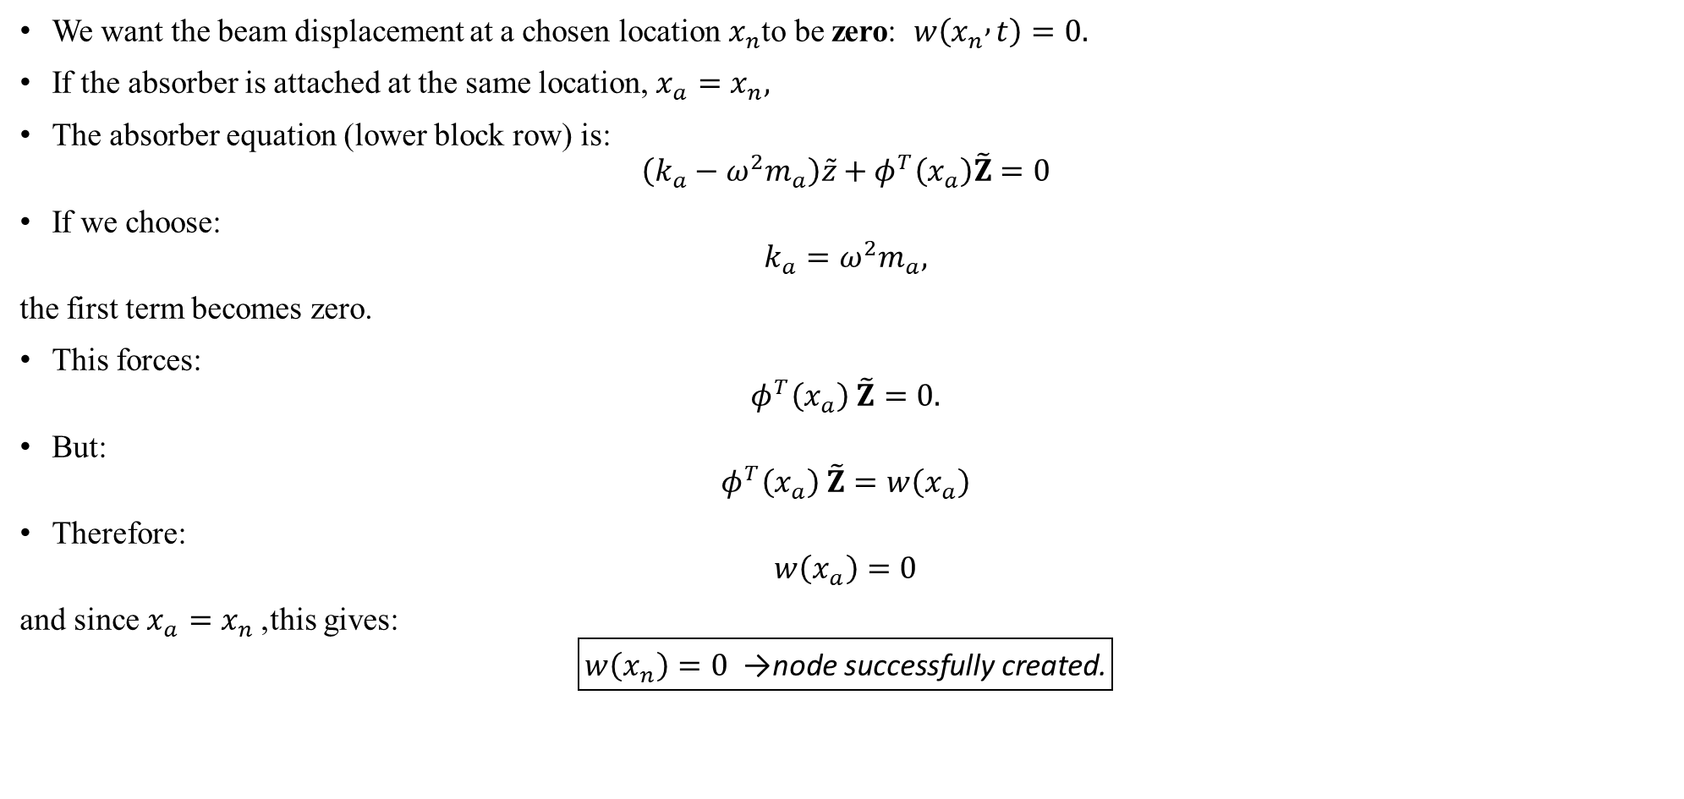
Work Done
We want the beam displacement at a chosen location $x_{n}$to be zero: $w\left(x_{n} , t\right)=0.$
If the absorber is attached at the same location, $x_{a}=x_{n},$
The absorber equation (lower block row) is:
$$\left(k_{a}−ω^{2}m_{a}\right)\tilde{z}+φ^{T}\left(x_{a}\right)\tilde{Z}=0$$
If we choose:
$$k_{a}=ω^{2}m_{a},$$
the first term becomes zero.
This forces:
$$φ^{T}\left(x_{a}\right) \tilde{Z}=0.$$
But:
$$φ^{T}\left(x_{a}\right) \tilde{Z}=w\left(x_{a}\right)$$
Therefore:
$$w\left(x_{a}\right)=0$$
and since $x_{a}=x_{n}$, this gives:
$$\boxed{w\left(x_{n}\right)=0 \text{→ }\text{node} \text{successfully} \text{created}\text{.}}$$

Slide 17
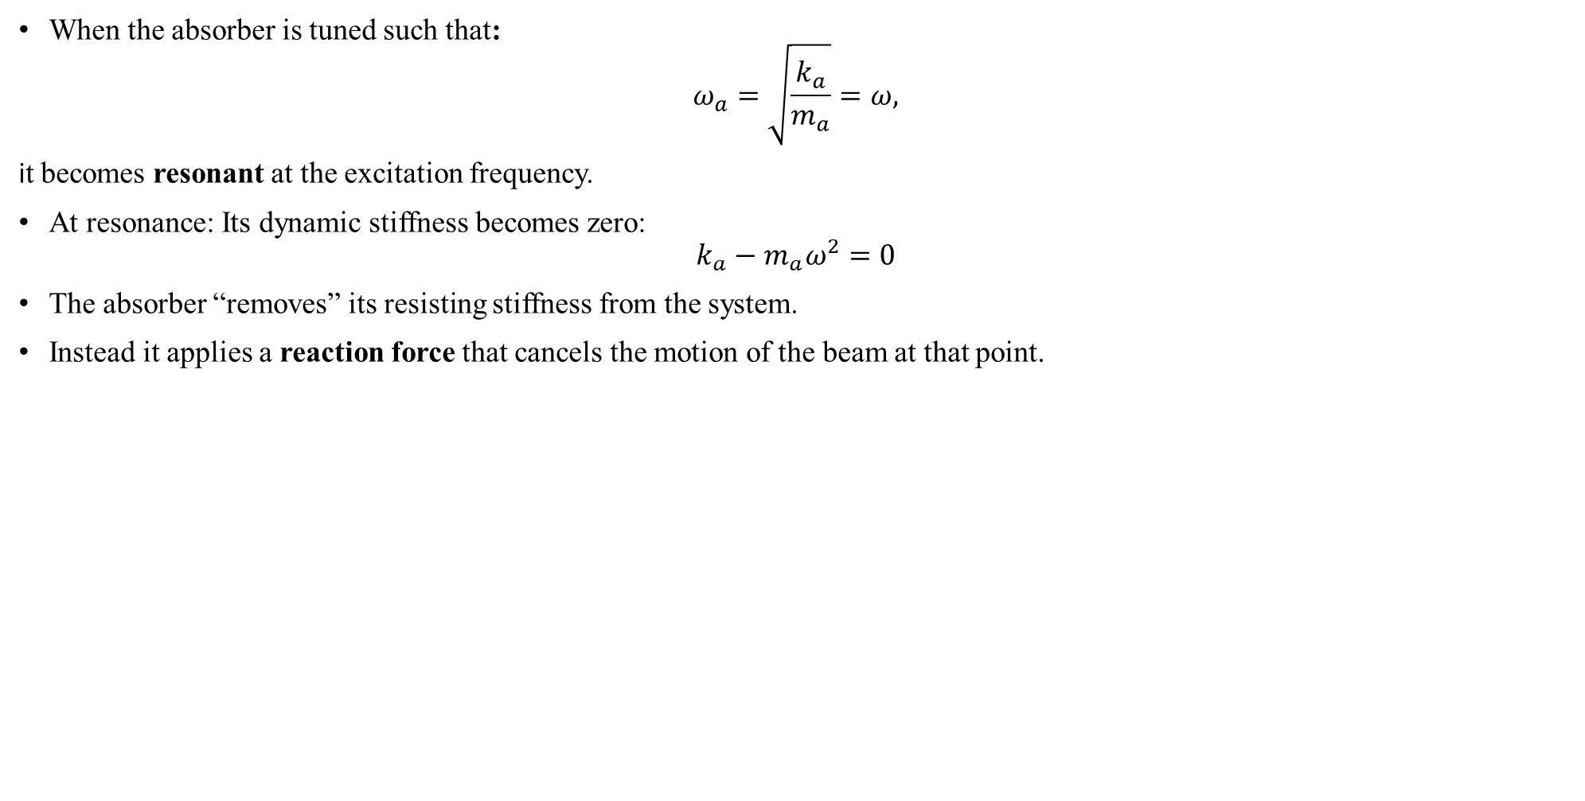
Work Done
When the absorber is tuned such that:
$$ω_{a}=\sqrt{\frac{k_{a}}{m_{a}}}=ω,$$
it becomes resonant at the excitation frequency.
At resonance: Its dynamic stiffness becomes zero:
$$k_{a}−m_{a}ω^{2}=0$$
The absorber “removes” its resisting stiffness from the system.
Instead it applies a reaction force that cancels the motion of the beam at that point.
Fig 9.Grass trimmer lumped mass system model

Slide 18
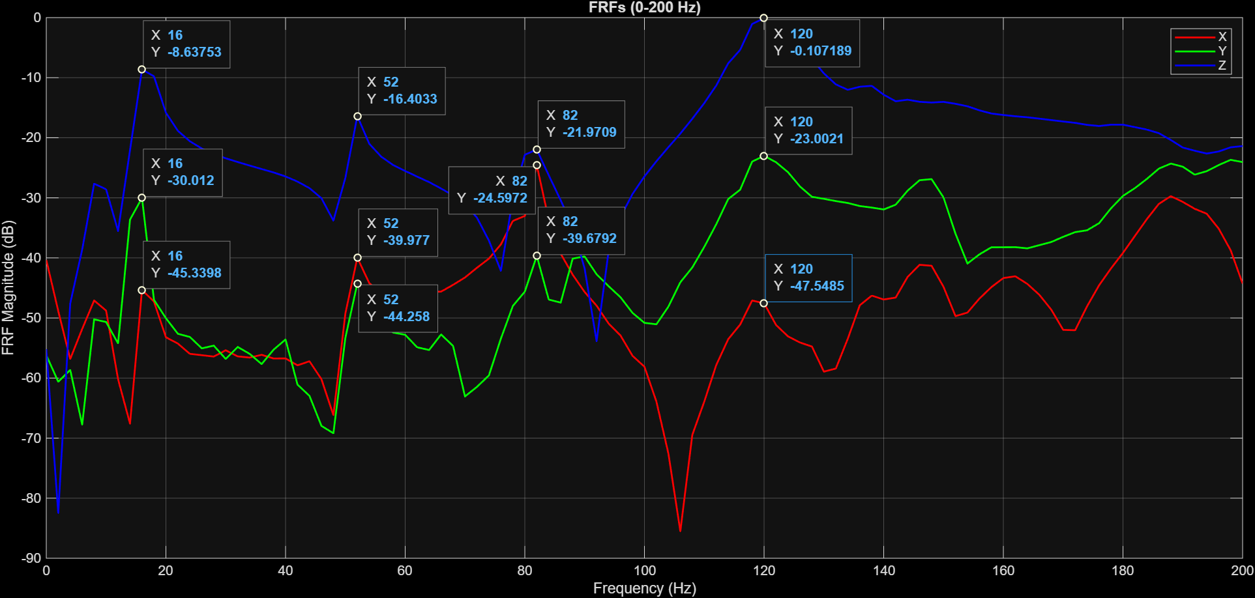
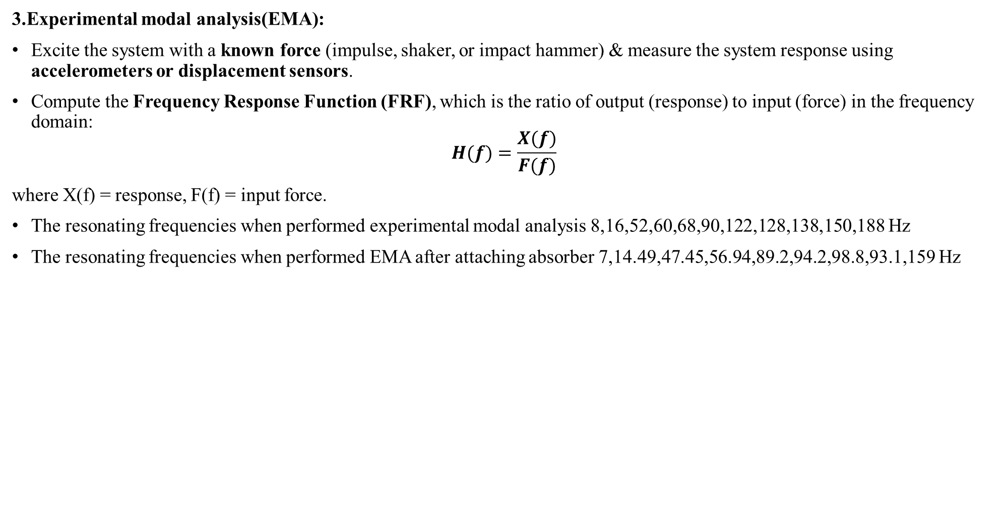
Work Done
3.Experimental modal analysis(EMA):
Excite the system with a known force (impulse, shaker, or impact hammer) & measure the system response using accelerometers or displacement sensors.
Compute the Frequency Response Function (FRF), which is the ratio of output (response) to input (force) in the frequency domain:
$$H(f)=\frac{X(f)}{F(f)}$$
where X(f) = response, F(f) = input force.
The resonating frequencies when performed experimental modal analysis 8,16,52,60,68,90,122,128,138,150,188 Hz
The resonating frequencies when performed EMA after attaching absorber 7,14.49,47.45,56.94,89.2,94.2,98.8,93.1,159 Hz
Fig 10.
(a)EMA setup for grass trimmer system
(b)FRF graph for the primary system(i.e. without absorber)
(a)
(b)

Slide 19
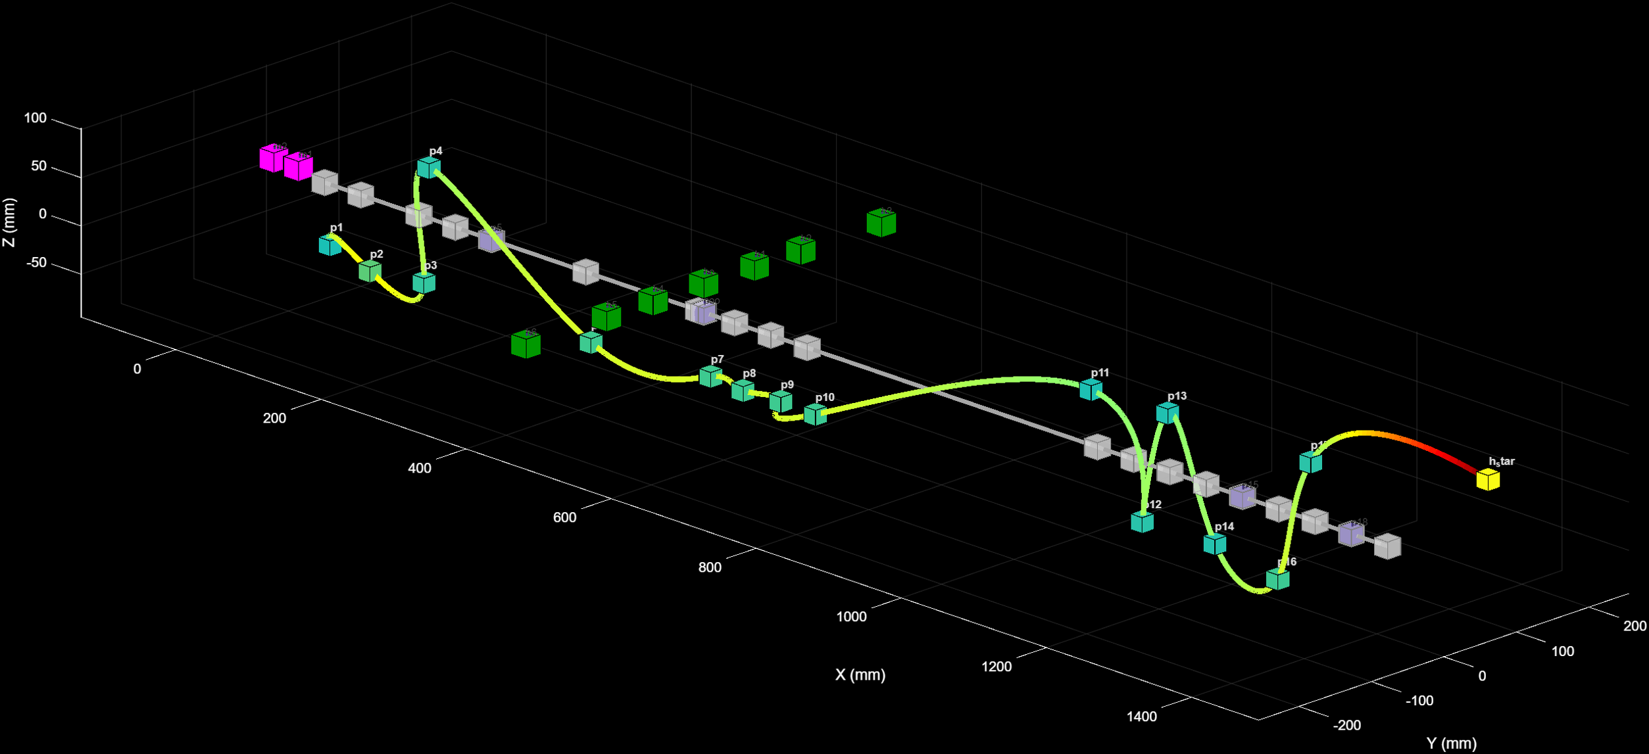
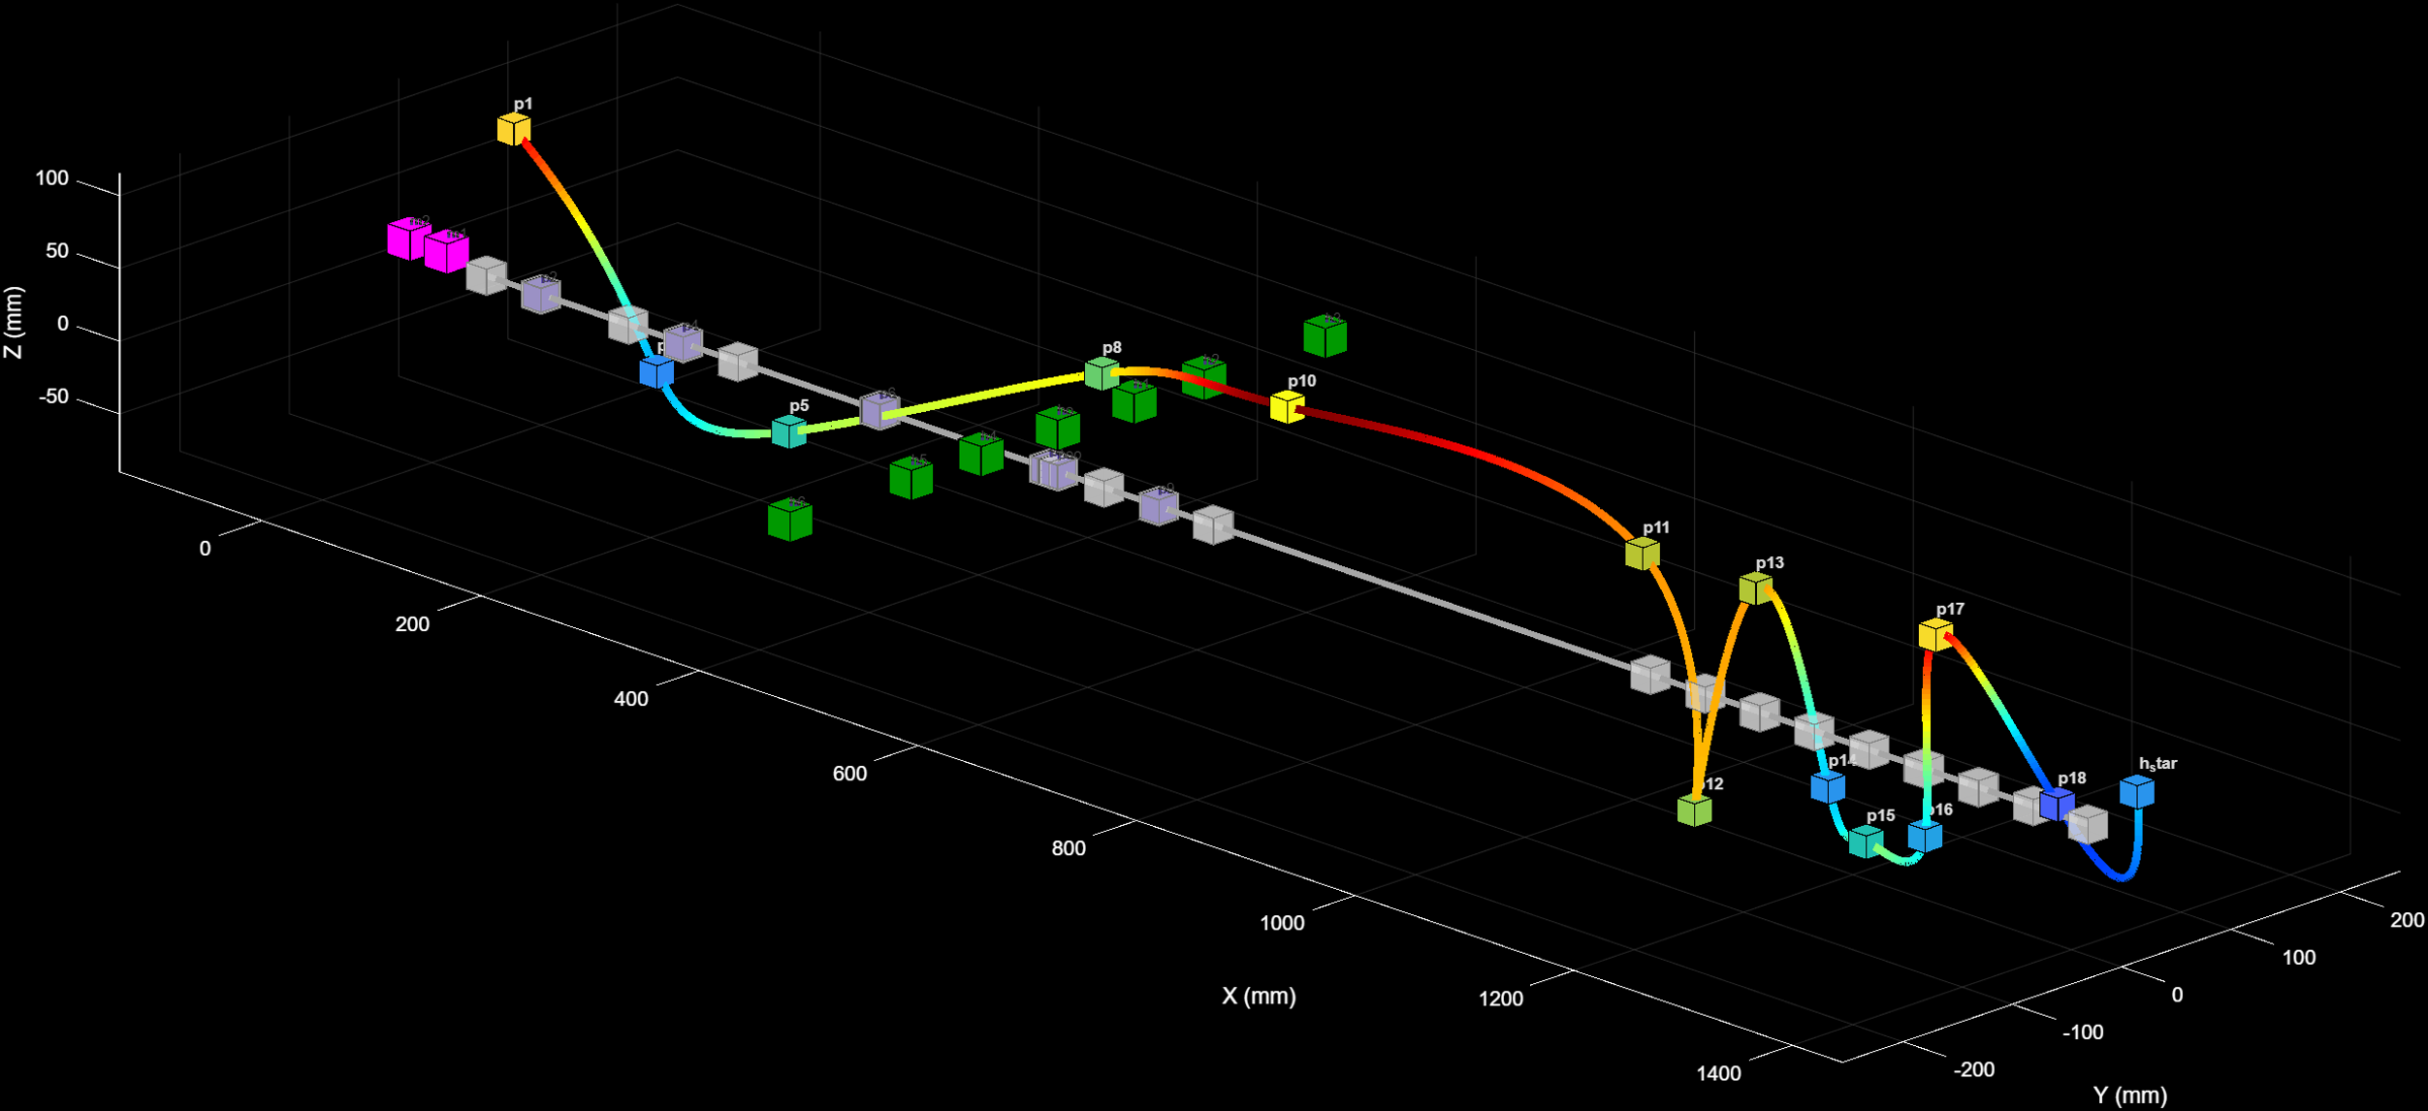
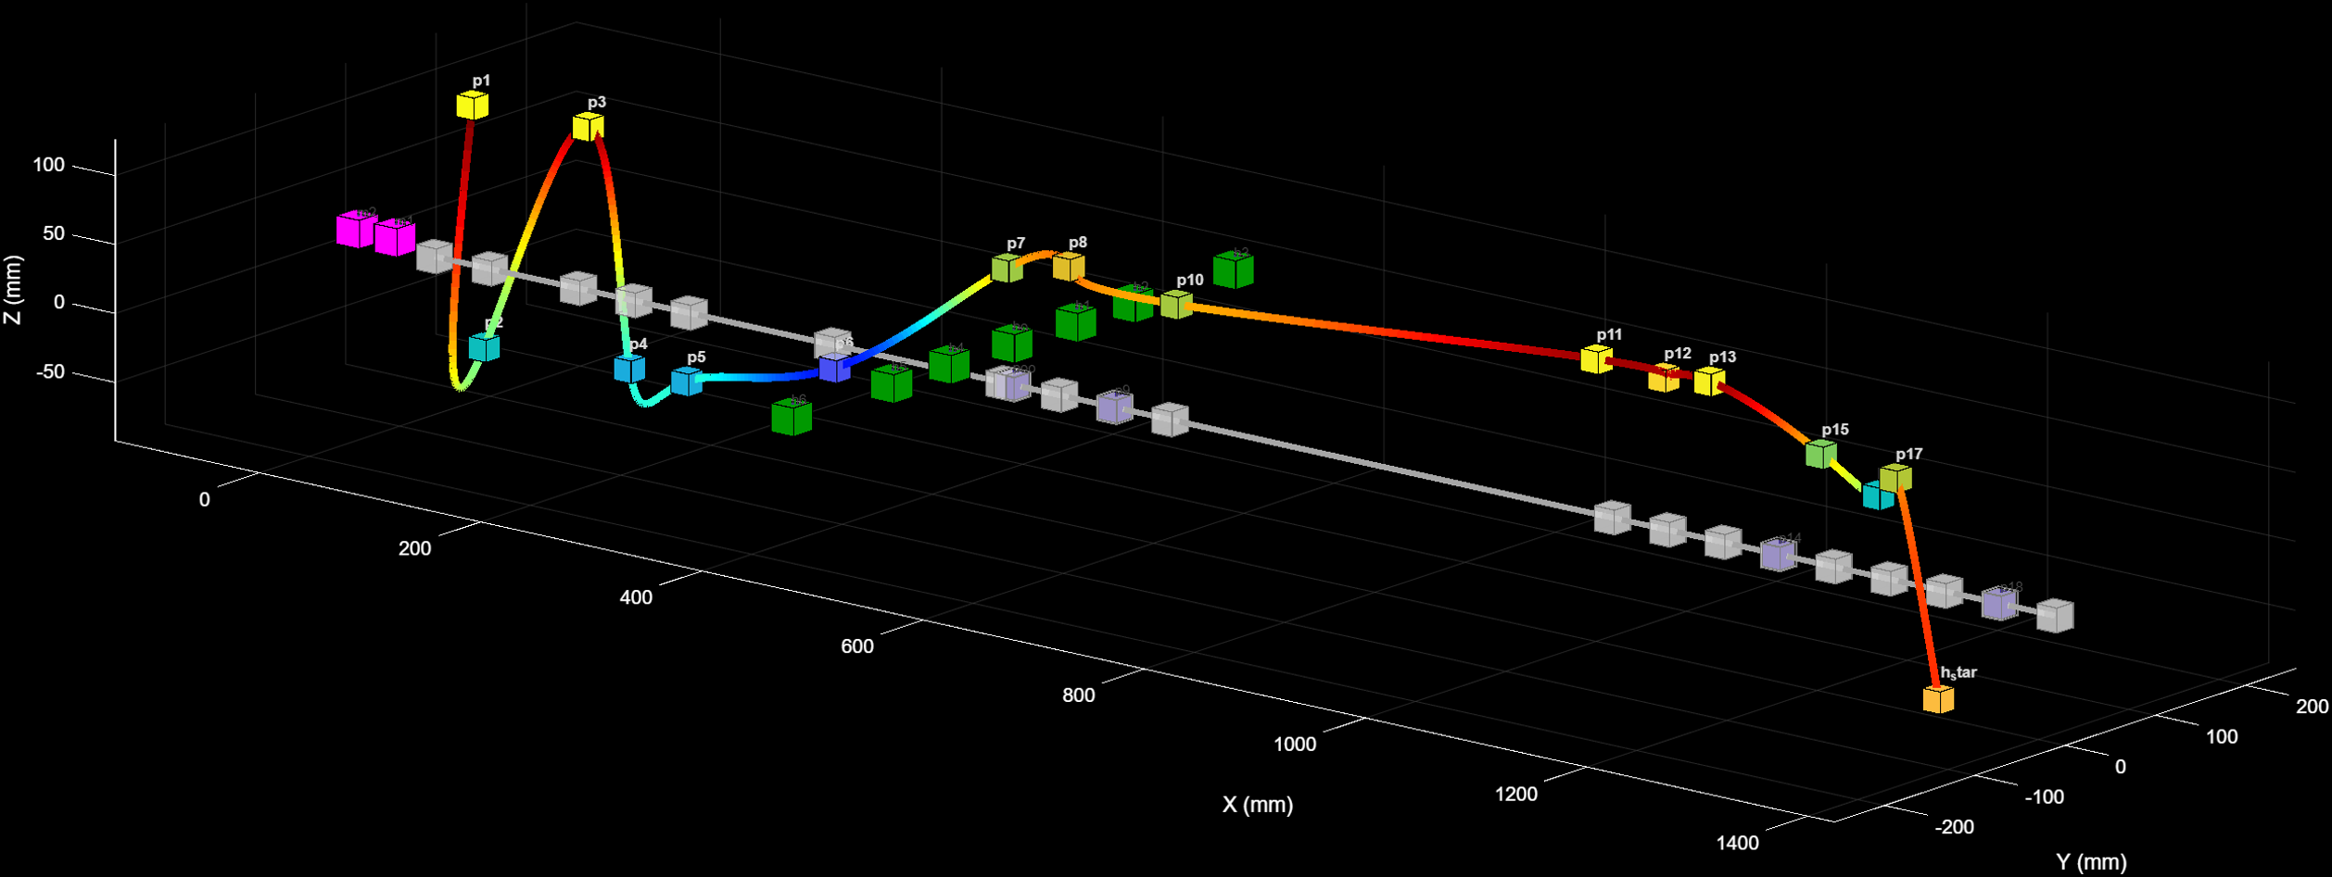
Work Done
Mode shapes:
A mode shape is the pattern of vibration of a structure at a particular natural frequency.
Every mechanical structure (beam, rod, trimmer pipe, absorber, etc.) vibrates in certain fixed patterns.
These patterns depend only on the geometry, material, and boundary conditions.
At each natural frequency, the shape in which the structure bends or oscillates is called the mode shape.
Fig 11.(a, b, c) Mode shapes for the primary system at 8,52,82 Hz respectively
(a)
(b)
(c)

Slide 20
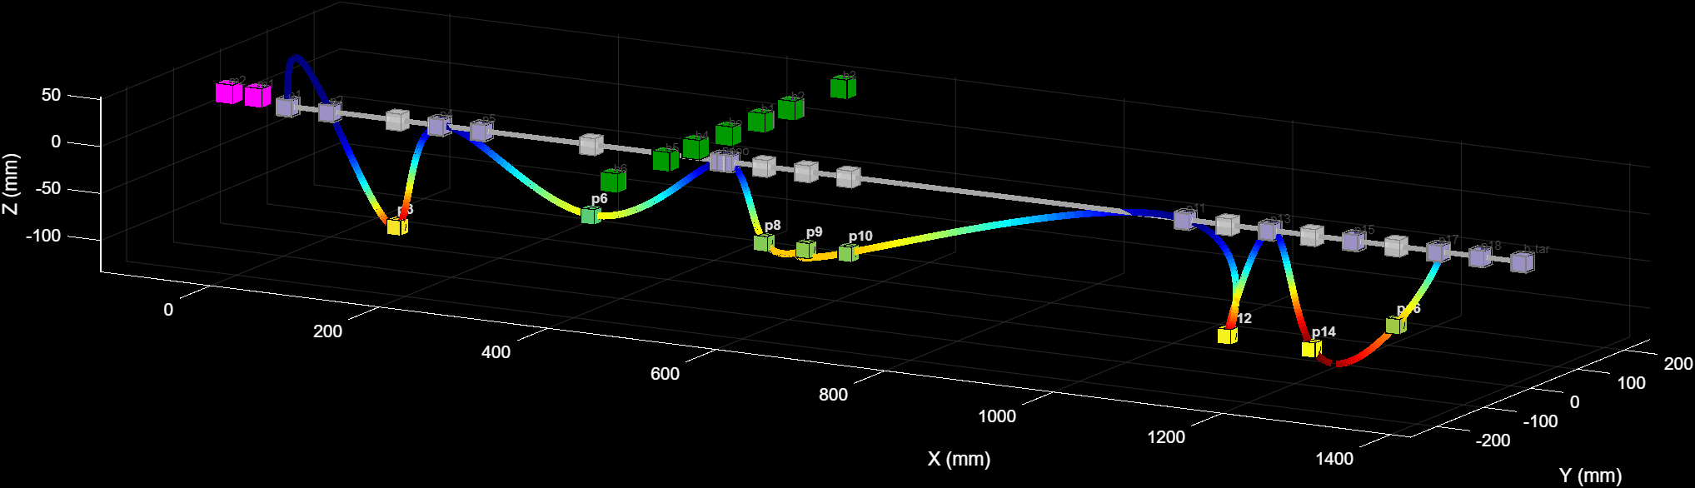
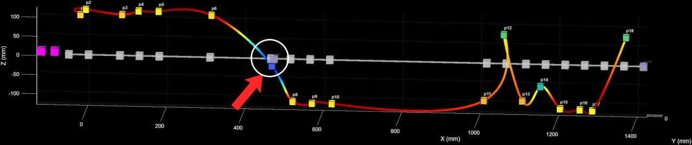
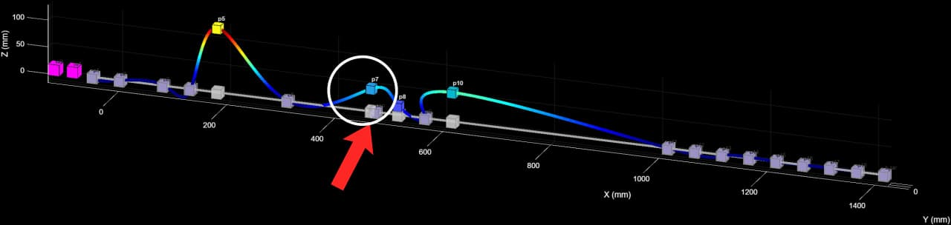
Work Done
Imposing a node means forcing a particular point on the structure to have zero vibration.
Fig 12.(a) Mode of the system after attaching the absorber at 7Hz
Fig 12.(b) Mode of the system after attaching the absorber at 47.45Hz
Fig 12.(c) Mode of the system after attaching the absorber at 89.2Hz

Slide 21
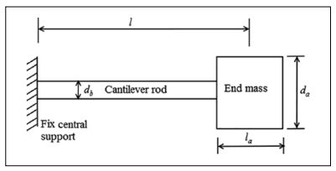
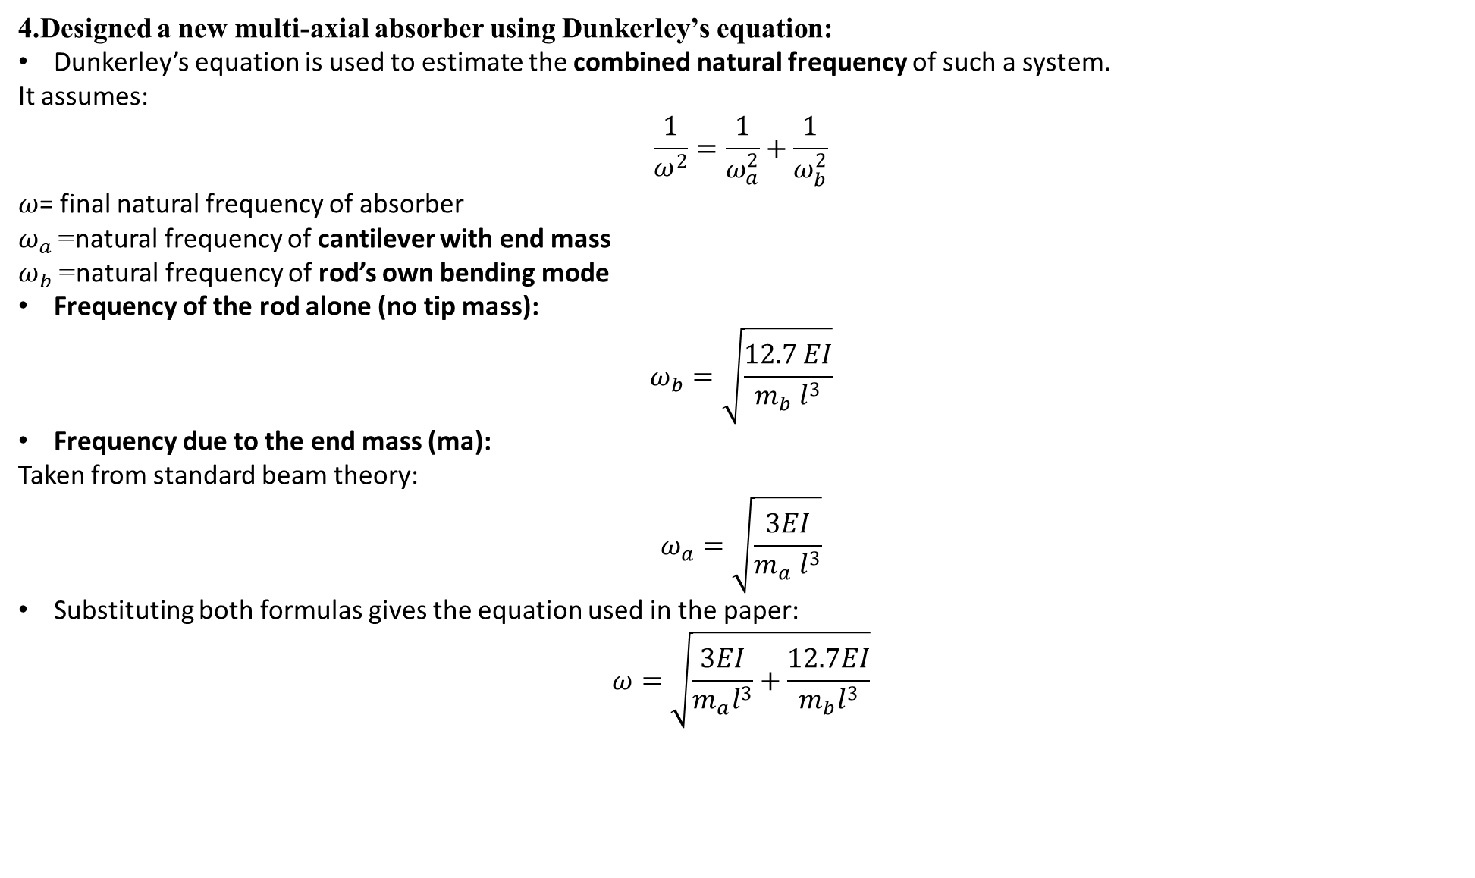
Work Done
4.Designed a new multi-axial absorber using Dunkerley’s equation:
Dunkerley’s equation is used to estimate the combined natural frequency of such a system.
It assumes:
$$\frac{1}{ω^{2}}=\frac{1}{ω_{a}^{2}}+\frac{1}{ω_{b}^{2}}$$
$ω$= final natural frequency of absorber
$ω_{a}$= natural frequency of cantilever with end mass
$ω_{b}$= natural frequency of rod’s own bending mode
Frequency of the rod alone (no tip mass):
$$ω_{b}=\sqrt{\frac{12.7 EI}{m_{b} l^{3}}}$$
Frequency due to the end mass (ma):
Taken from standard beam theory:
$$ω_{a}=\sqrt{\frac{3EI}{m_{a} l^{3}}}$$
Substituting both formulas gives the equation used in the paper:
$$ω=\sqrt{\frac{3EI}{m_{a}l^{3}}+\frac{12.7EI}{m_{b}l^{3}}}$$
Fig 13. Dimensions of the absorber system used for discrete system analysis.

Slide 22
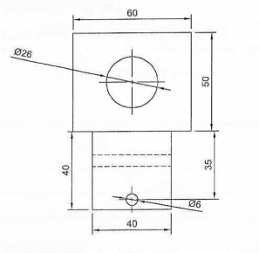
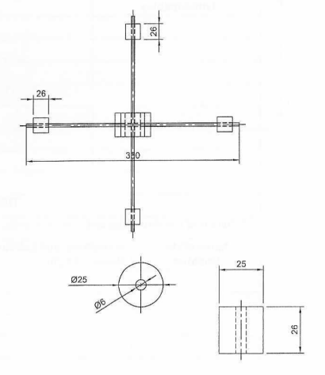
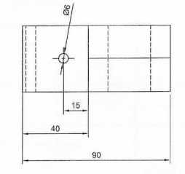
Work Done
5.Fabricated absorber with 0.1 kg end masses ,7 mm rods and Aluminium housing(0.5kg):
Housing
Threaded rod
End mass
(b)
Fig 14.
Design of the absorber.
Multi axial absorber.
(a)

Slide 23
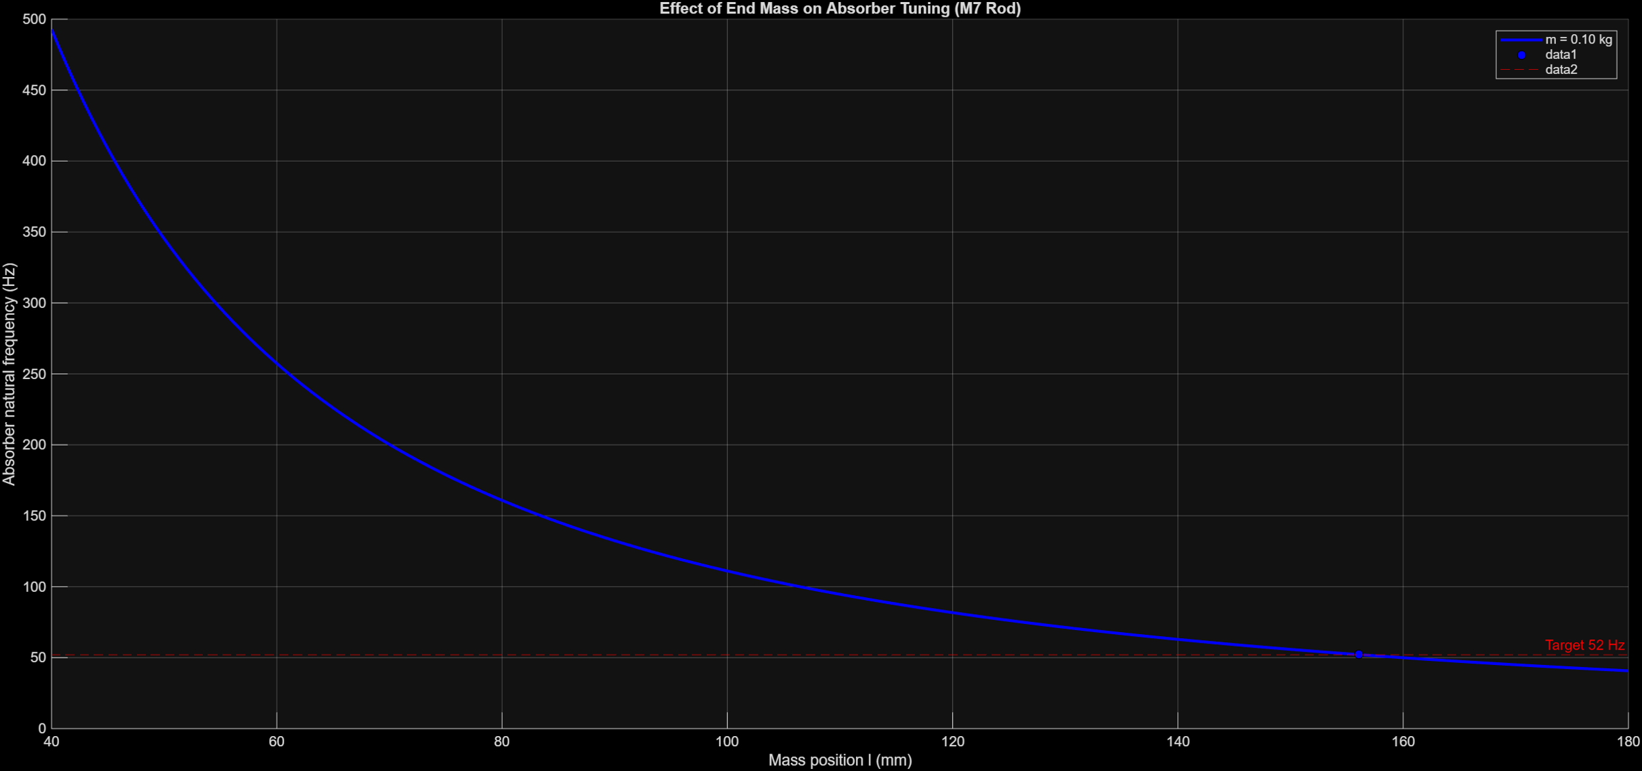
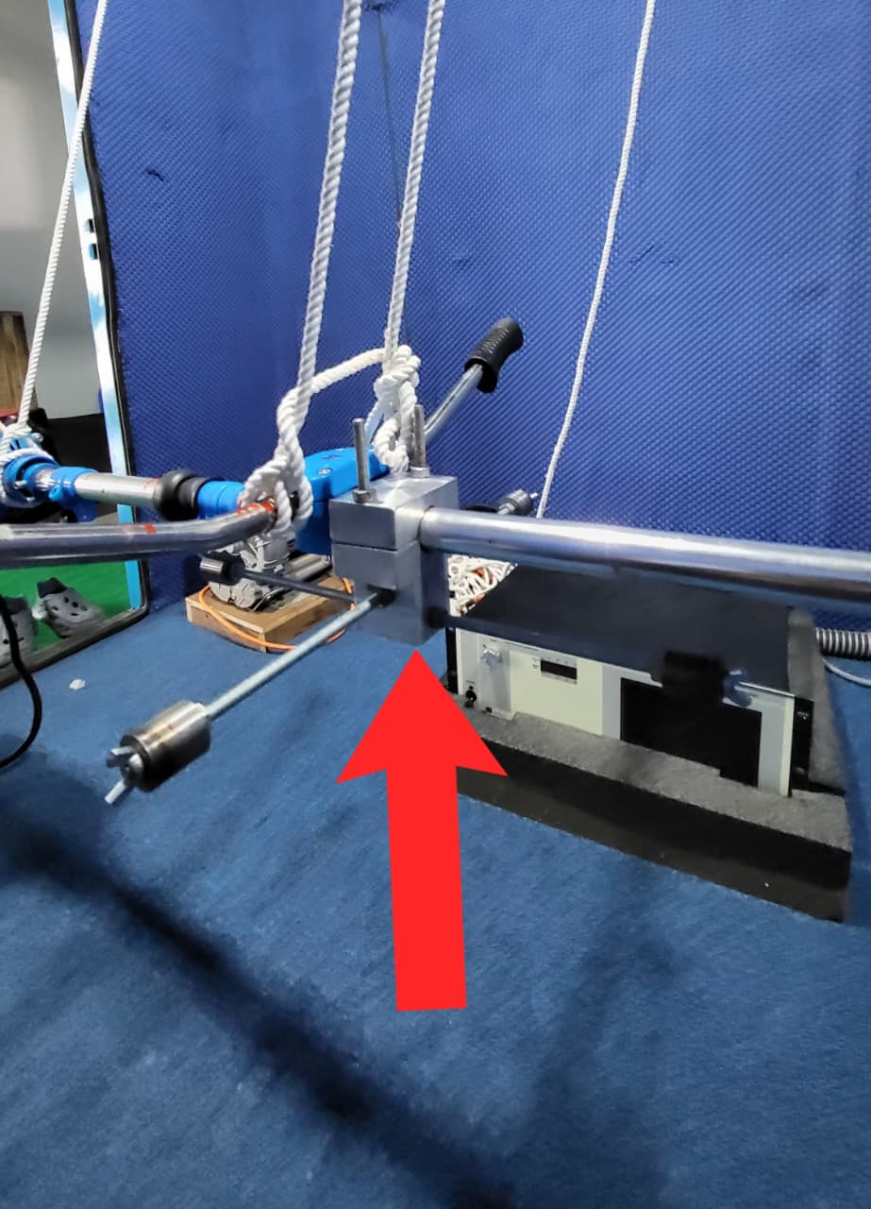
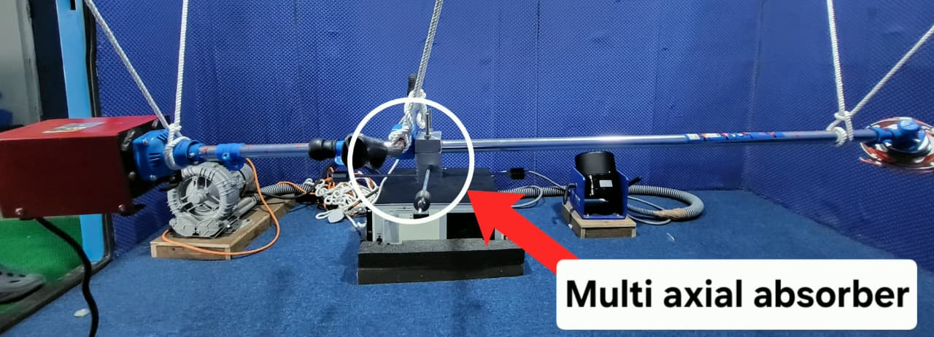
Work Done
6.Mounted absorber near handle and tuned to 52 Hz.
Fig 15.
(a)Effect of end mass on absorber frequency.
(b, c)Grass trimmer system with multi axial absorber.
Tunning length = 156mm.
(a)
(b)
(c)

Slide 24
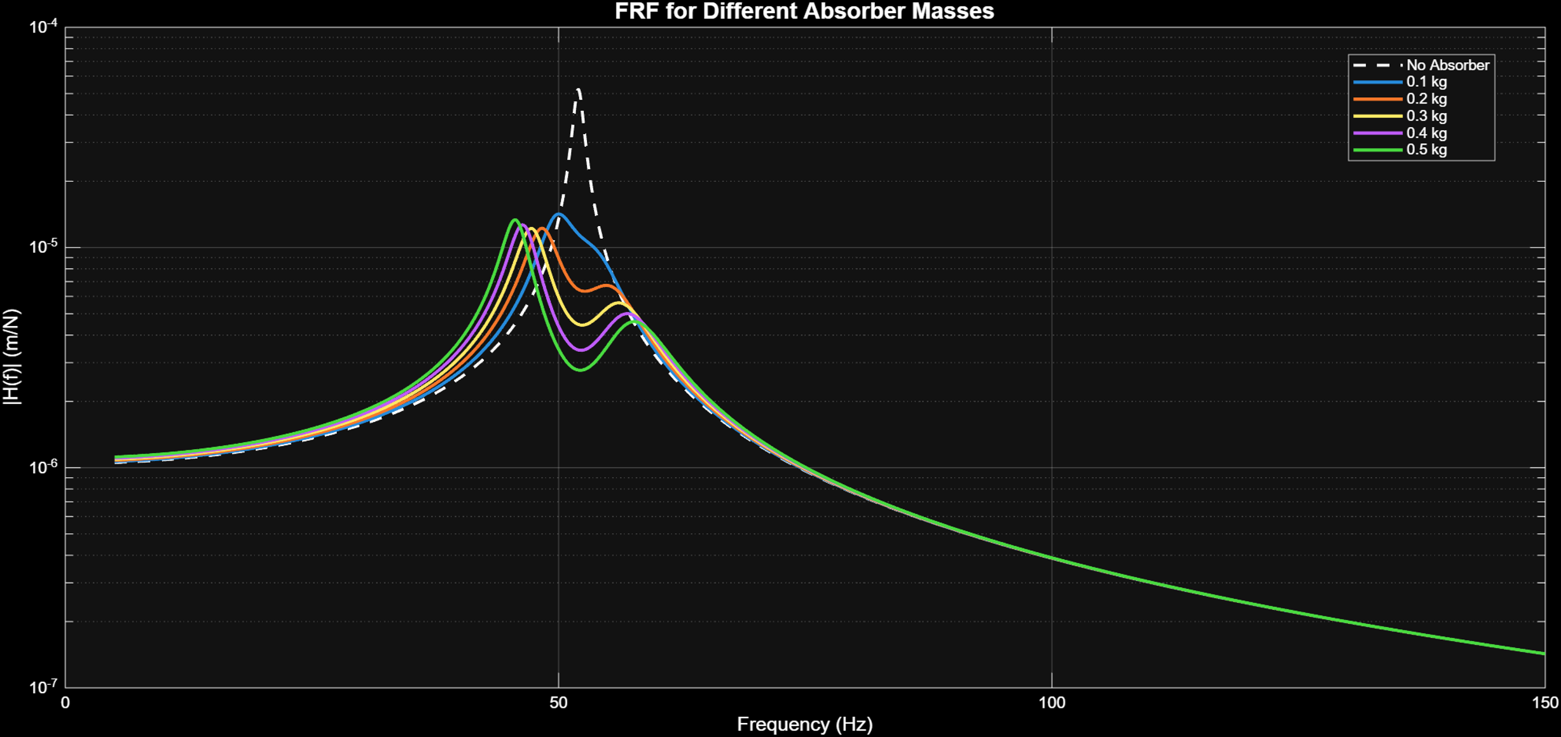
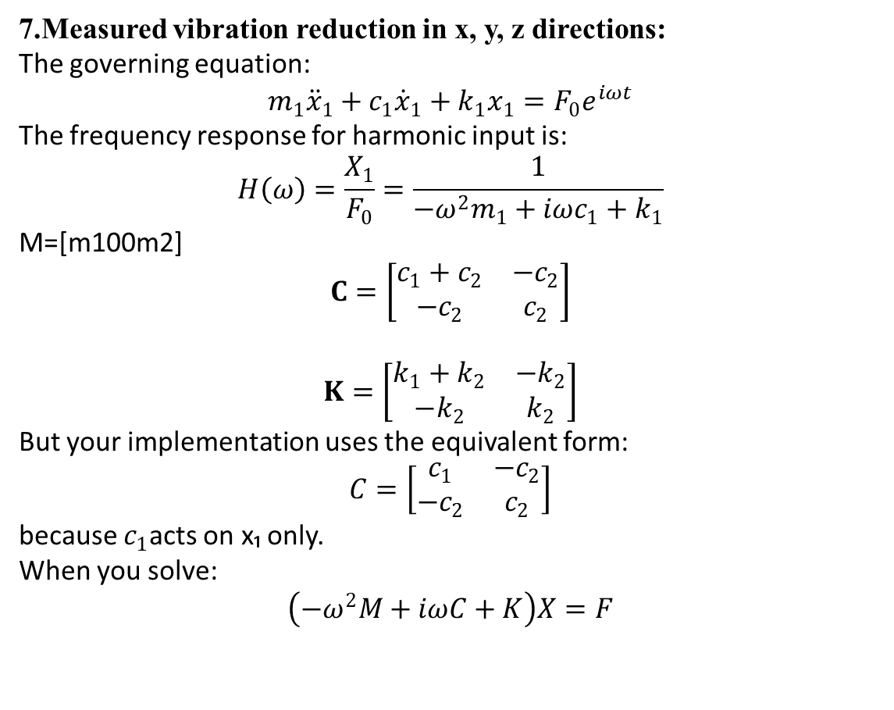
Result
7.Measured vibration reduction in x, y, z directions:
The governing equation:
$$m_{1}{\ddot{x}}_{1}+c_{1}{\dot{x}}_{1}+k_{1}x_{1}=F_{0}e^{iωt}$$
The frequency response for harmonic input is:
$$H\left(ω\right)=\frac{X_{1}}{F_{0}}=\frac{1}{−ω^{2}m_{1}+iωc_{1}+k_{1}}$$
M=[m1​0​0m2​​]
$$C=\left[\begin{matrix}c_{1}+c_{2} & −c_{2} \\ −c_{2} & c_{2}\end{matrix}\right]$$
$$K=\left[\begin{matrix}k_{1}+k_{2} & −k_{2} \\ −k_{2} & k_{2}\end{matrix}\right]$$
But your implementation uses the equivalent form:
$$C=\left[\begin{matrix}c_{1} & −c_{2} \\ −c_{2} & c_{2}\end{matrix}\right]$$
because $c_{1}$acts on x₁ only.
When you solve:
$$\left(−ω^{2}M+iωC+K\right)X=F$$
Fig 16.FRF of simple spring mass system with absorber
Mass(kg) | Peak Amp(m/N) | Peak Freq(Hz) | At Freq(Hz) | RMS Red | Red(%)
0.10 | 1.338e-05 | 50.3 | 52 | 3.019e-06 | 71.82%
0.20 | 1.121e-05 | 48.33 | 52 | 3.695e-06 | 76.39%
0.30 | 1.103e-05 | 47.24 | 52 | 4.022e-06 | 76.76%
0.40 | 1.132e-05 | 46.34 | 52 | 4.227e-06 | 76.15%
0.50 | 1.183e-05 | 45.57 | 52 | 4.373e-06 | 75.09%

Slide 25
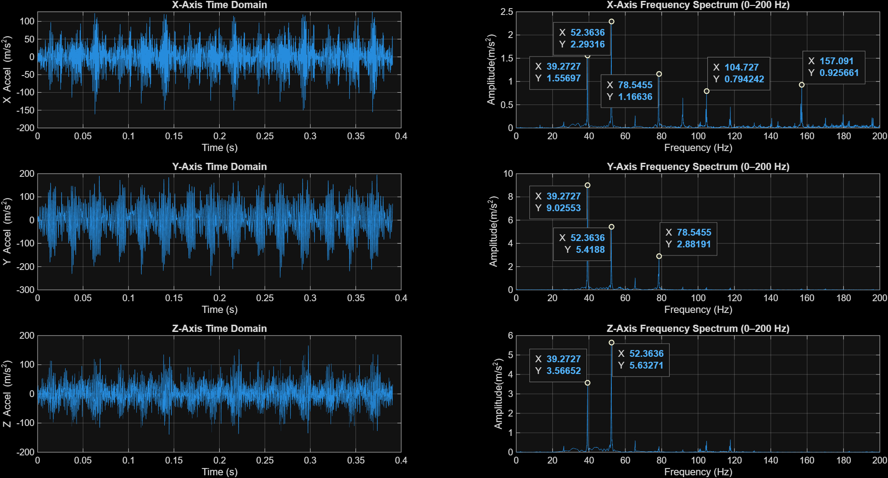
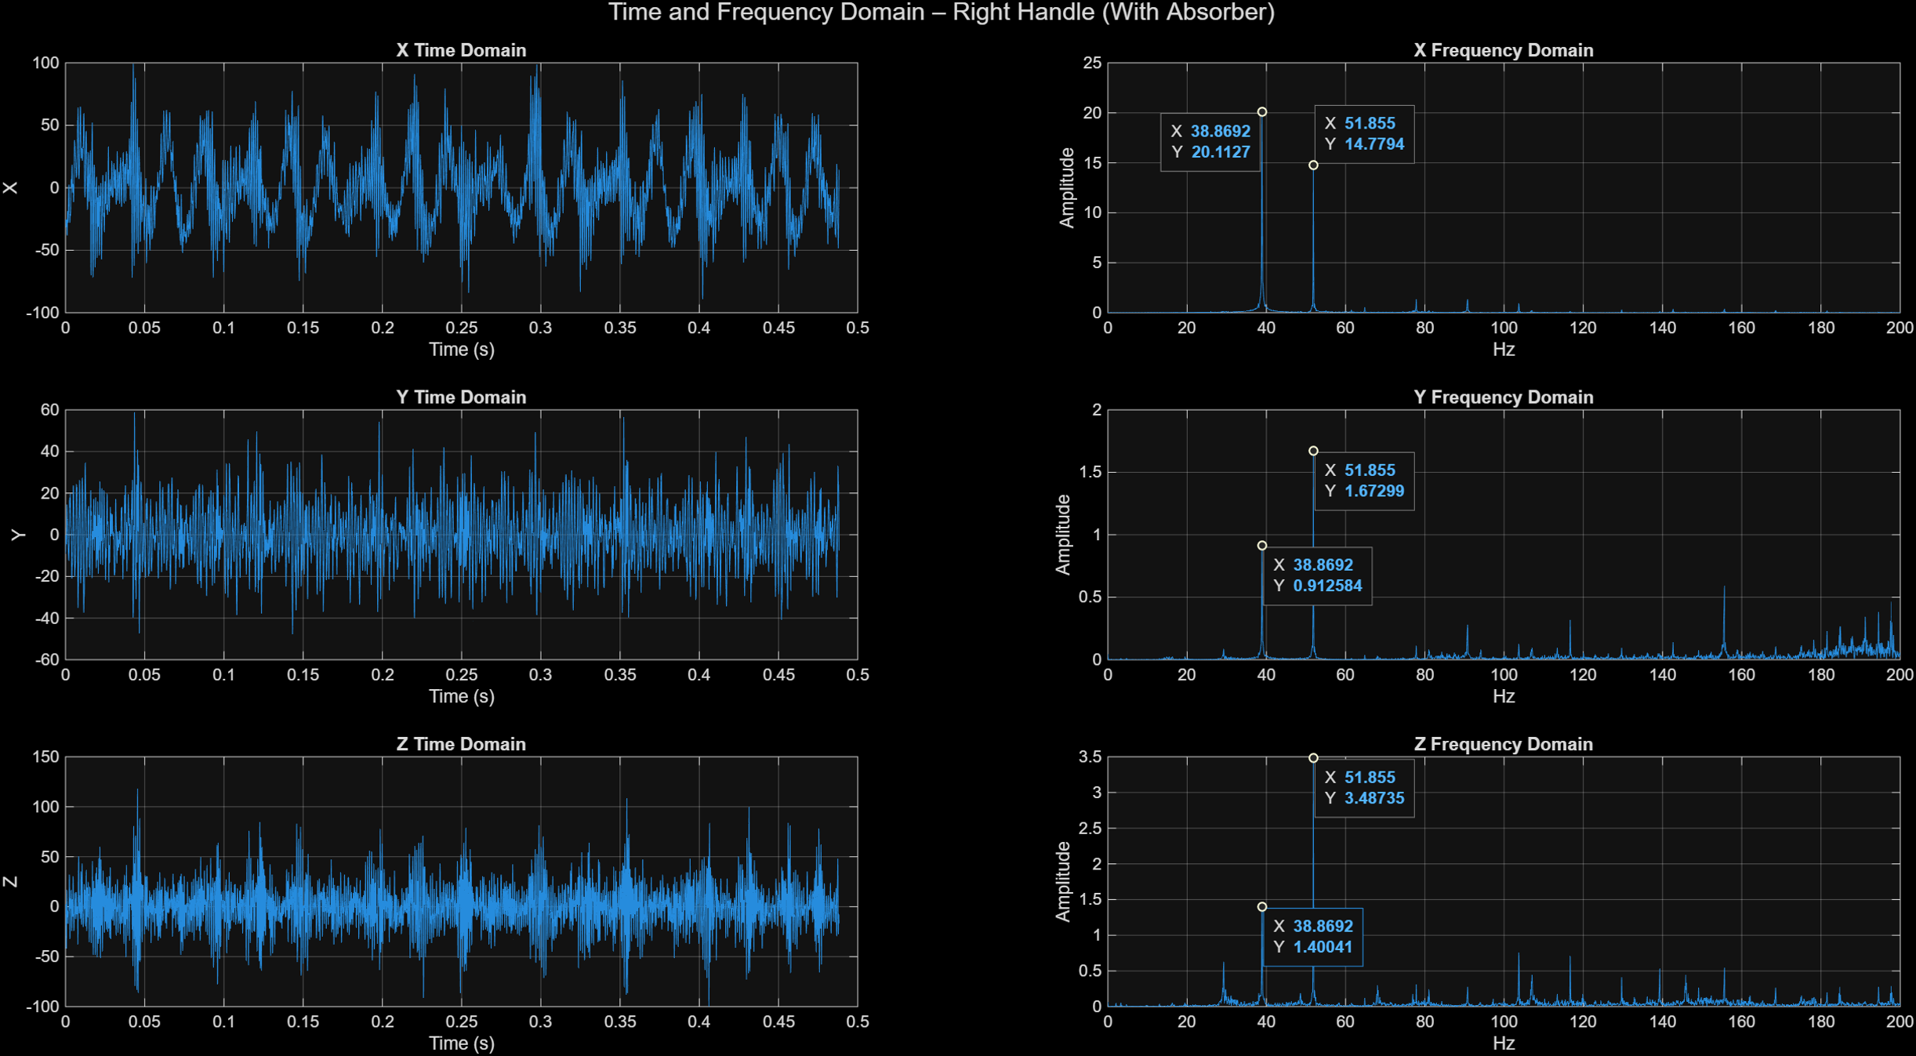
Result
8.Measured vibration reduction in x, y, z directions:(Experimental)
VIBRATION AMPLITUDE (Displacement in mm): (before-after)
RMS Amplitude:
X-axis: 74.762 → 43.161 | Δ = -31.601 mm
Y-axis: 15.947 → 9.648 | Δ = -6.299 mm
Z-axis: 32.004 → 16.533 | Δ = -15.471 mm Peak-to-Peak Amplitude:
X-axis: 254.727 → 147.057 | Δ = -107.670 mm(42.22%)
Y-axis: 53.823 → 32.563 | Δ = -21.260 mm(39.49%)
Z-axis: 96.656 → 49.932 | Δ = -46.723 mm(48.34%)
Frequency weighted rms acceleration reduction (ISO 5349):
(in g=9.81ms-2)
X-axis (Wd): 48.343 → 27.909 | Δ = -20.4 g
Y-axis (Wd): 16.371 → 9.904 | Δ = -6.467 g
Z-axis (Wk): 40.769 → 21.061 | Δ = -19.708 g
(a)
(b)
Fig 17. Before (a)and after(b) Time and frequency spectrum of the grass trimmer system

Slide 26
Conclusion
The study successfully designed and tested a tunable multi-axial vibration absorber for petrol grass trimmers.
Experimental modal analysis confirmed that the absorber’s natural frequencies lie between 40-80Hz, allowing effective tuning to the trimmer’s operating frequency of 52 Hz.
Installing the absorber near the handle significantly reduced vibration amplitude in x, z, and even y-directions during both lab (no-load) and field (grass-cutting) conditions.
The multi-axial absorber outperformed the single-axis absorber by a large margin:
42.00% reduction (x-axis),
39.49% reduction(y-axis),
48.34% reduction(z-axis)
Overall, the research demonstrates that a simple, low-cost, and tunable multi-directional absorber can drastically reduce harmful handle vibration and improve operator safety.

Slide 27
Future works
Optimising absorber mass and stiffness Increasing the absorber mass further may provide even lower vibration levels, but needs balancing with total tool weight .
Developing lightweight materials for absorber rods and housing The current design uses steel rods and aluminium housing. Future designs can use composites or advanced alloys to reduce weight while maintaining stiffness.
Modelling full 3-axis coupling effects The analytical model does not include bending–axial coupling, while experiments show vibration reduction in y-direction . Analytical models can be improved for more accuracy.
Testing under varying engine speeds and different grass loads Absorber tuning is based on a single operating speed . Real machines operate across a range of speeds, so adaptive/tunable mechanisms can be explored.
Integration with commercial trimmer designs Future research can explore OEM integration, ergonomics, durability in field conditions, and mass production feasibility.

Slide 28
Reference literature
Cha PD. Imposing nodes at arbitrary locations for general elastic structures during harmonic excitations. J Sound Vib 2004; 272: 853–868.
Cha PD and Rinker JM. Enforcing nodes to suppress vibration along a harmonically forced damped Euler-Bernoulli beam. ASME J Vib Acoust 2012; 134(5): 051010.
Cha PD and Buyco K. An efficient method for tuning oscillator parameters in order to impose nodes on a linear structure excited by multiple harmonics. ASME J Vib Acoust 2015; 137(3): 031018.
Patil SS and Awasare PJ. Vibration reduction at desired locations on a beam by creating nodes using tunable vibration neutralizers. J Vib Control 2016; 22(1): 205–223.
Hao KY, Mei LX and Ripin ZM. Tuned vibration absorber for suppression of hand-arm vibration in electric grass trimmer. Int J Ind Ergonom 2011; 41: 494–508.
Nor AA, Mohad IG, Musli NY, et al. Hand-arm vibration disorder among grass-cutter workers in Malaysia. Int J Occup Saf Ergon 2016; 22(3): 433–438.
Mohamad HA, Nor AA and Musli NY. Prediction on hand arm vibration exposure cause-effect among grass-cutting workers in Malaysia. Int J Eng Tech 2018; 7: 48–54.

